Slide 1
IT 356: Introduction To Computer Graphics (Lecture 04)
School of Information Technology
Illinois State University
Dr. Qi Zhang, Spring 2024

Slide 2
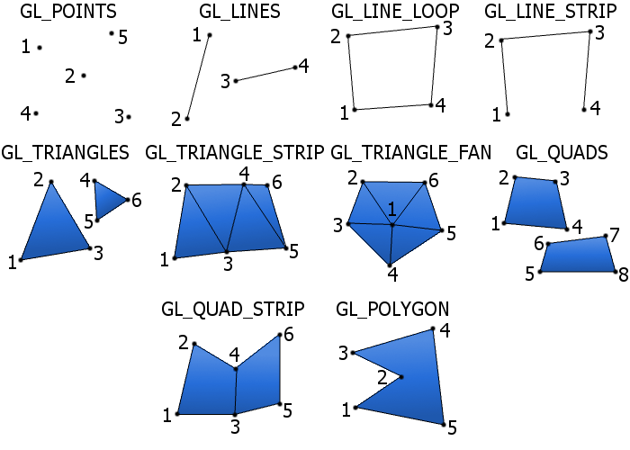
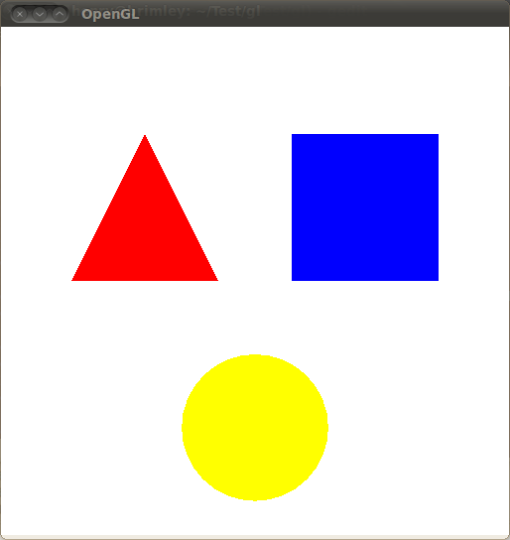
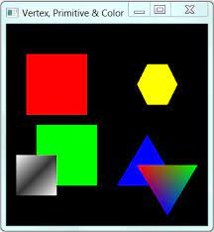
Drawing Primitives
Primitives are basic shapes that you can easily draw.
It can be a triangle, a square, or even a single point.
We are going to learn how to draw some basic primitives, including points, triangles, and different polygons.

Slide 3
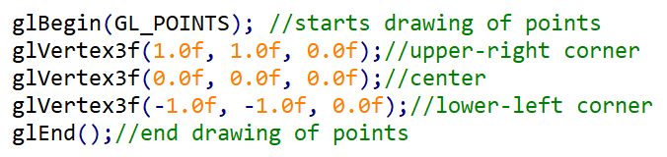
Immediate Mode
The easiest way to do drawing in OpenGL is by using Immediate Mode.
For this, you use the glBegin() function, which takes the “mode” or type of object you want to draw as one parameter.

Slide 4
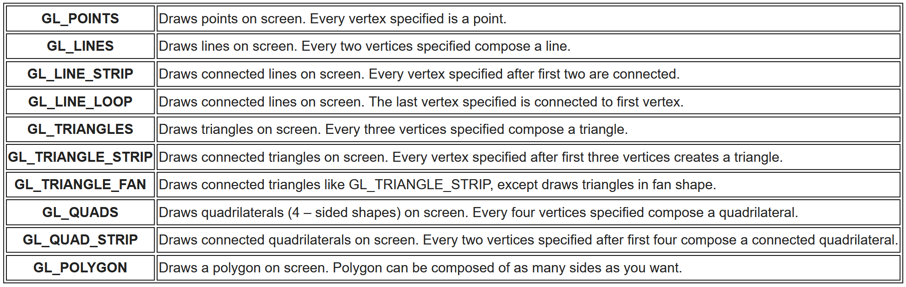
Immediate Mode
Here is a list of the possible modes and what they mean:
When you are done drawing all the vertices of the specific primitive, you put in the next line the glEnd() function which ends the drawing of that primitive.

Slide 5
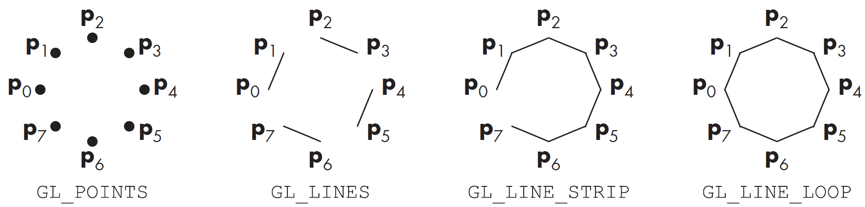
Types of Primitives
GL_POINTS
Simply draws the points in the order you pass them in.
GL_LINES
Takes pairs of vertices and draws lines between them
GL_LINE_STRIP
Takes any number of vertices and draws a series of connected line segments
GL_LINE_LOOP
Same as GL_LINE_STRIP, except that it connects the first and last vertices.

Slide 6
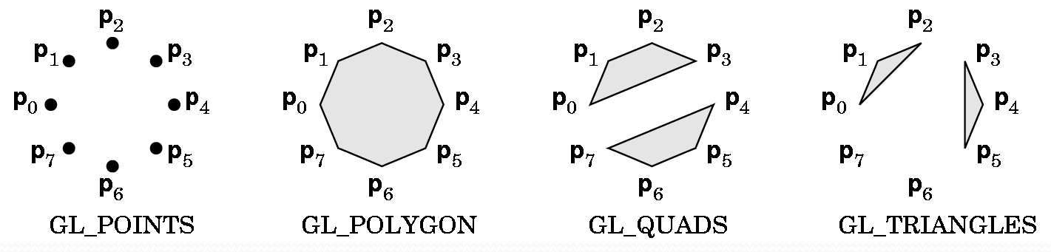
Types of Primitives
GL_TRIANGLES
Takes vertices in triples and draws them as triangles.
GL_QUADS
Takes vertices in quadruples and draws them as four-sided-polygons.
GL_POLYGON
Takes any number of vertices and draws the boundary of the convex polygon they form.
Note: The order of vertices here is important. All polygons must be convex, and their edges cannot intersect.

Slide 7
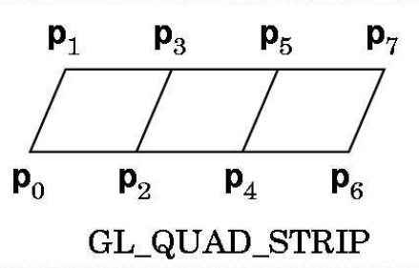
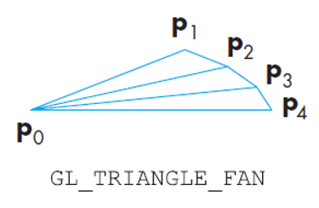
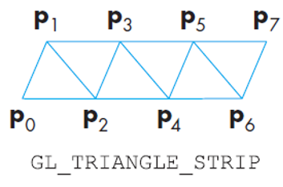
Types of Primitives
GL_TRIANGLE_STRIP
Takes any number of vertices and draws a strip of triangles.
Here: p0, p1, p2 followed by p2, p1, p3 followed by p2, p3, p4…
GL_QUAD_STRIP
Takes any number of vertices and draws a strip of quads.
Here: p0, p1, p3, p2 followed by p2, p3, p5, p4 …
GL_TRIANGLE_FAN
Takes any number of vertices and draws a circular fan of triangles starting from the first vertex.
Would draw: p0, p1, p2 followed by p0, p2, p3 followed by p0, p3, p4 …

Slide 8
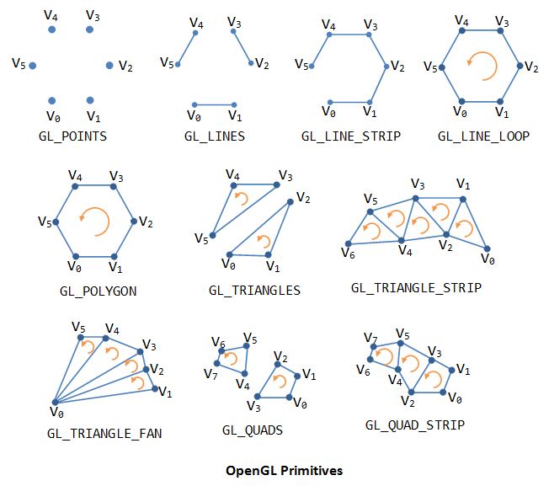
Geometric Primitives
In OpenGL, an object is made up of geometric primitives such as triangle, quad, line segment, and point
OpenGL supports the listed primitives:

Slide 9
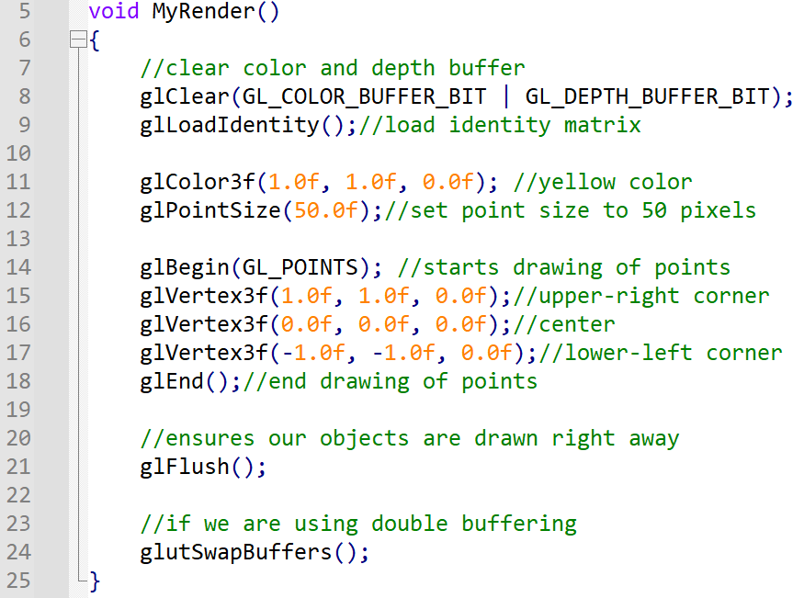
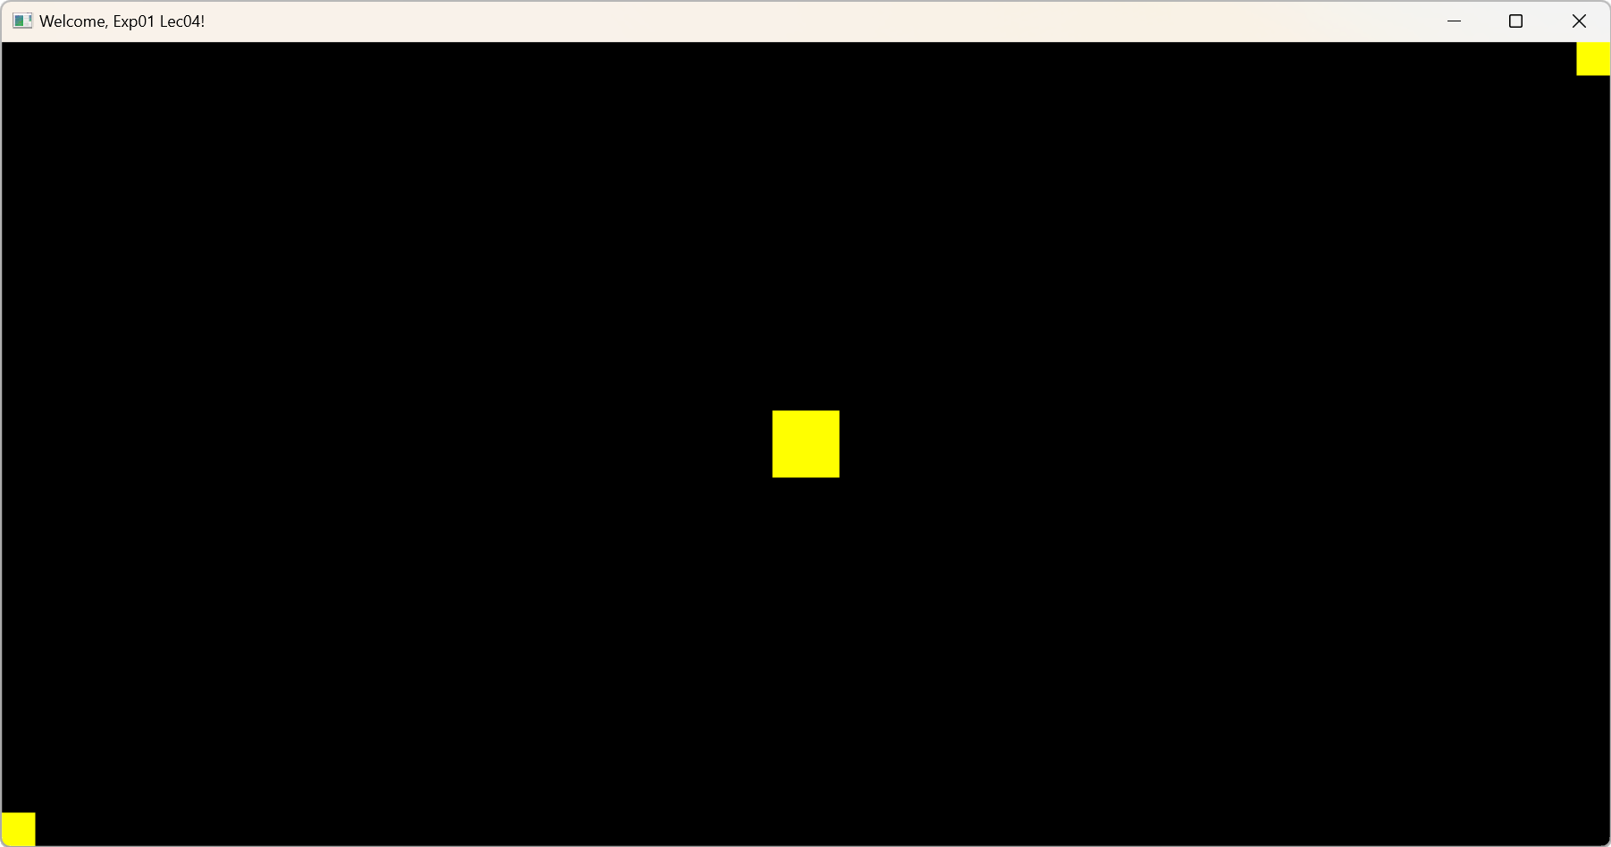
Drawing Points
Now in the myRender() function, before you write the glBegin() code, we will set the point size to 50 pixels in size
After that, any drawing of points will be drawn 50 pixels in size.

Slide 10
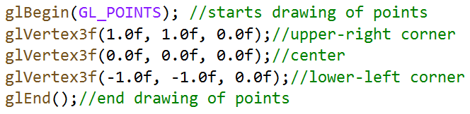
Drawing Points
Now write the glBegin() function with the GL_POINTS mode parameter.
Then, after that, specify the vertices you want to use using the glVertex3f() function.
For this example, we want the upper–right corner (1.0,1.0,0.0) and the lower–left corner (-1.0,-1.0,0.0) of the screen to have a point. After drawing the points, make sure to end the drawing with the glEnd() function:

Slide 11
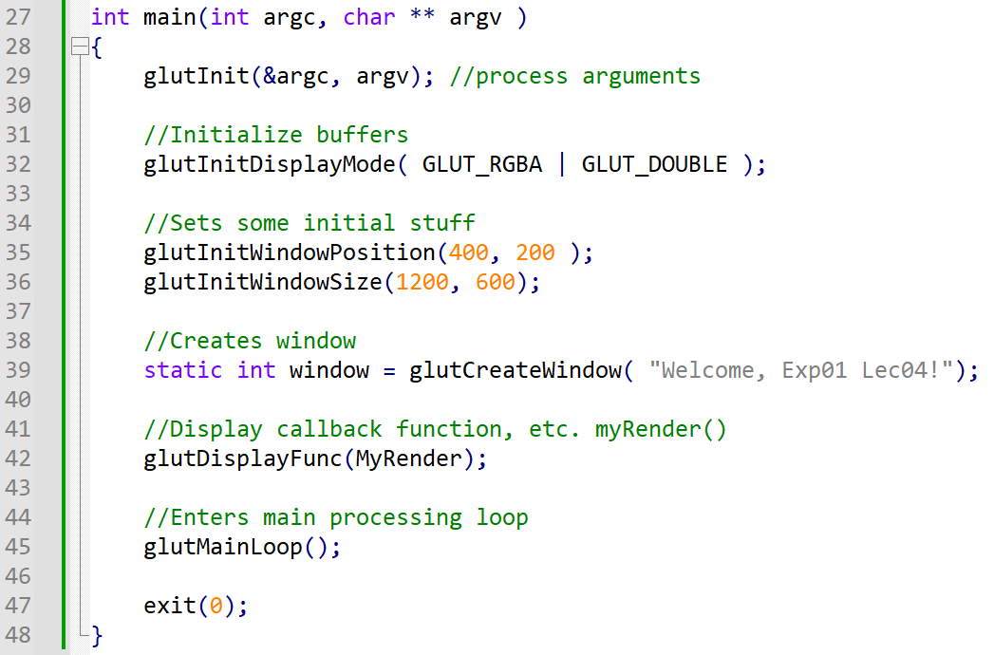
Drawing Points

Slide 12
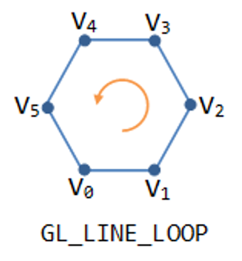
Drawing a Line Loop
A line loop requires at least two vertices.
Every vertex specified after that is connected to the vertex specified before it and the first vertex specified.
So, if we put a vertex to the left of the window, to the right of the window, on top and on the bottom, we would have a rotated square:
First, we use the glBegin() function and pass the parameter of GL_LINE_LOOP to tell OpenGL we are going to start drawing a line loop.

Slide 13
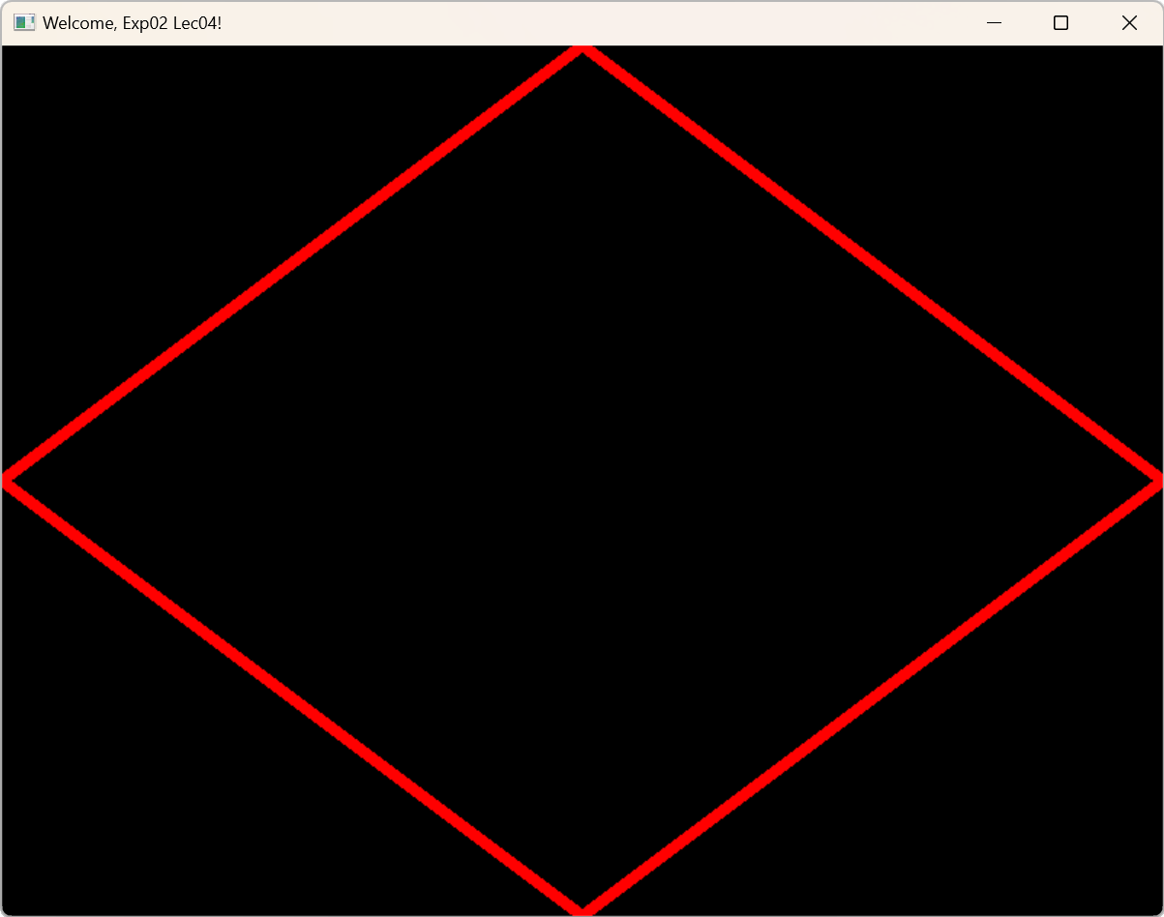
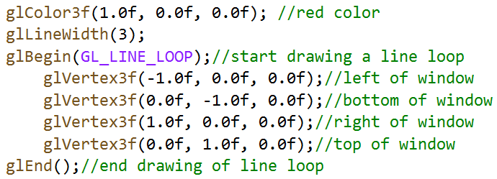
Drawing a Line Loop
Then we pass the four vertices to create the rotated square. The first vertex is to the left of the window (-1.0f,0.0f,0.0f), the second one is at the bottom of the window (0.0f,-1.0f,0.0f), the third at the right of the window (1.0f,0.0f,0.0f), and the fourth and last being at the top of the window (0.0f,1.0f,0.0f).
Then we make sure to put in glEnd() to tell OpenGL we are done drawing the line loop:

Slide 14
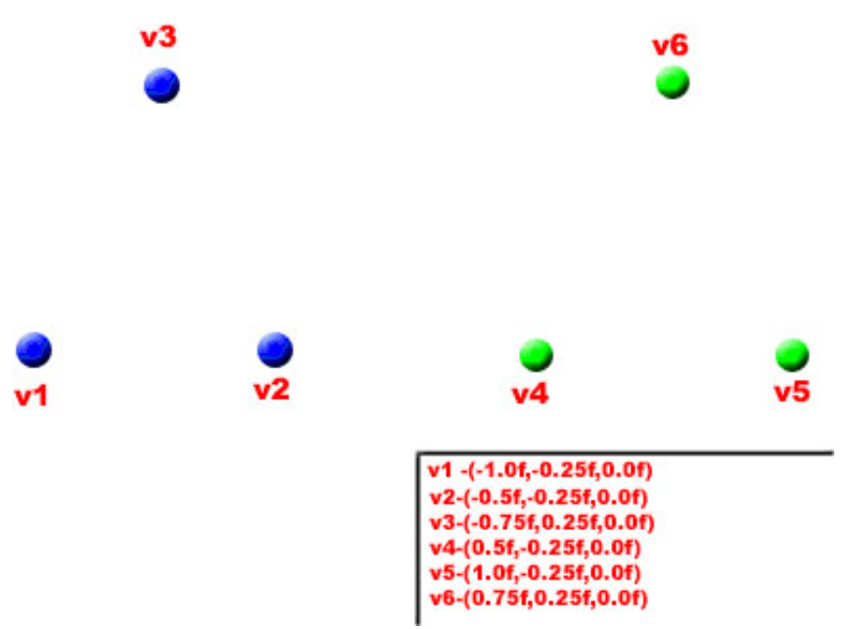
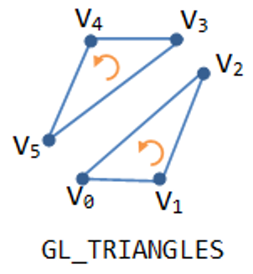
Drawing Triangles
Triangles are composed of three vertices.
For this example, we are going to use the regular GL_TRIANGLES mode to draw two triangles side by side.

Slide 15
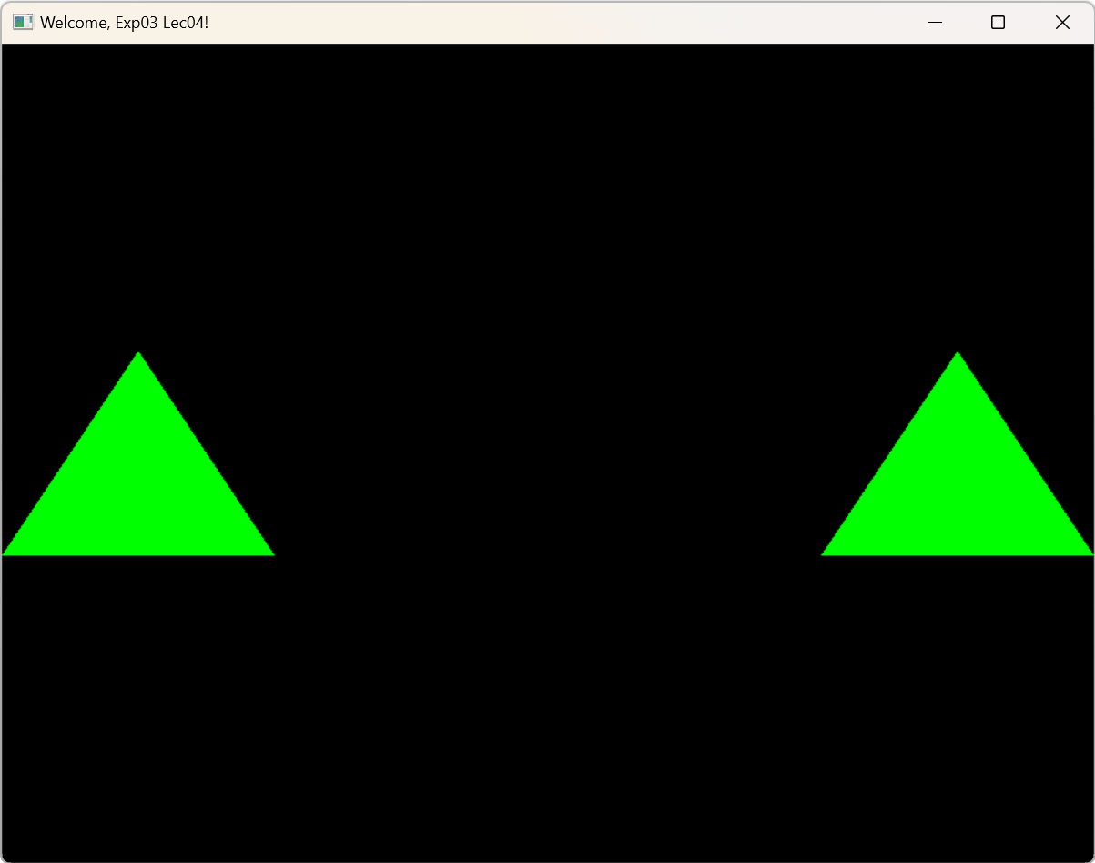
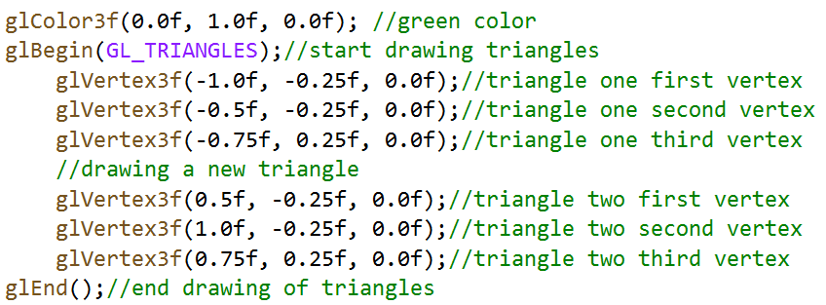
Drawing Triangles
First, we want a triangle to the left.
So, we need three vertices on the left side representing one triangle and three vertices on the right side of the window representing the second triangle.
Note that you don’t need two glBegin() functions to draw two triangles. Since the mode GL_TRIANGLES is plural, it can handle more than one triangle in between one glBegin() and glEnd() function call:

Slide 16
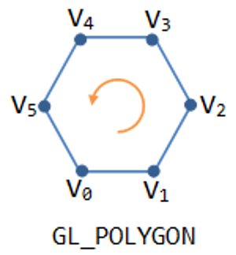
Drawing Polygons
Polygons consist of at least three vertices that, when connected, make up a shape.
In this example we are going to be using the GL_POLYGON mode to draw a six – sided shape.
The GL_POLYGON mode allows you to draw a shape with any number of sides as you want.
GL_POLYGON is a singular word (meaning no “S” at the end of the word), you can only draw one polygon between a glBegin() and glEnd() function call.

Slide 17
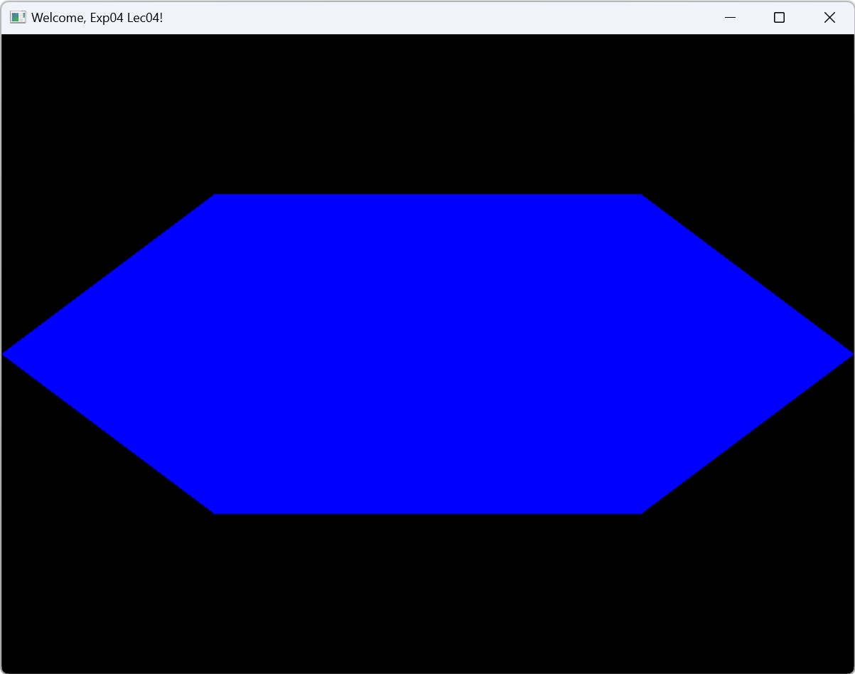
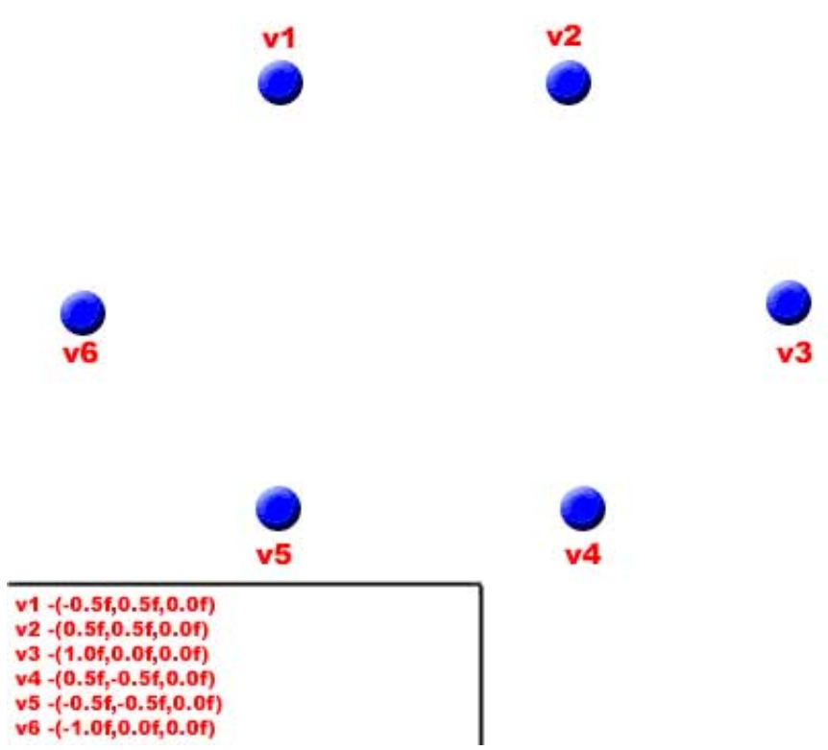
Drawing Polygons
Also, the last vertex you specify is automatically connected to the first vertex specified.
And of course, since a polygon is a closed shape, like the triangle, the shape will be filled with your specified color (which for now is blue). Here is the diagram for our six – sided shape:

Slide 18
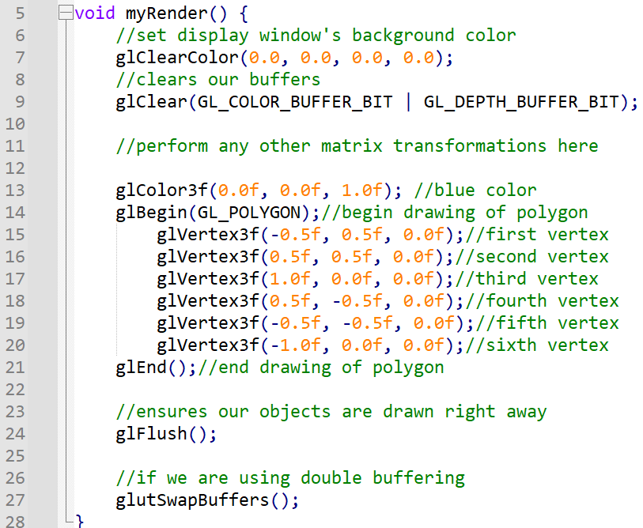
Drawing Polygons

Slide 19
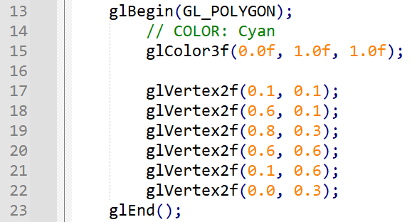
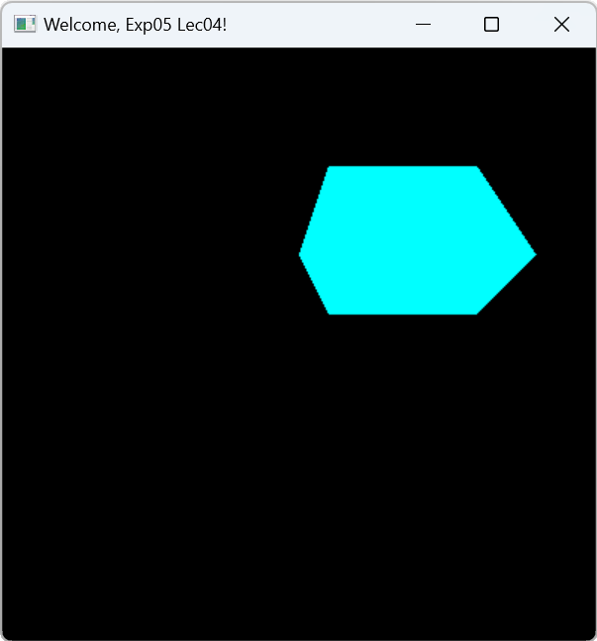
Code Example: exp05_lec04.cpp

Slide 20
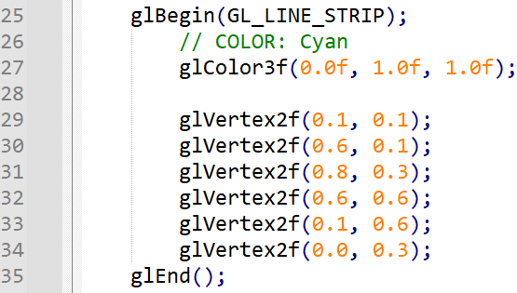
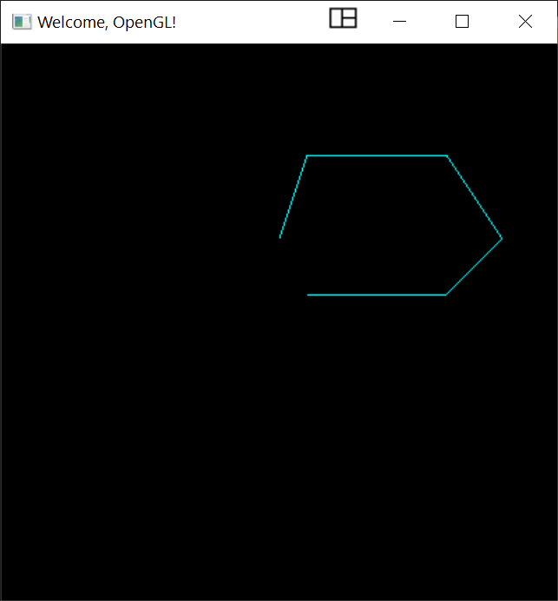
Code Example: exp05_lec04.cpp

Slide 21
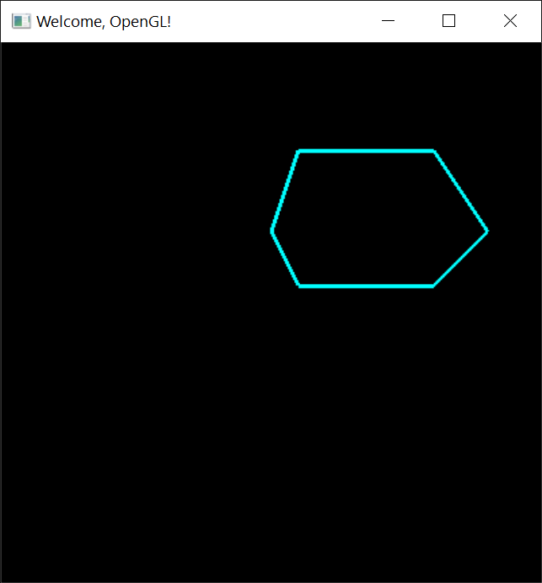
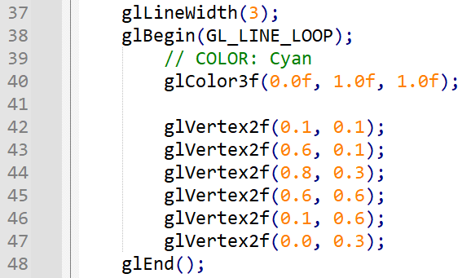
Code Example: exp05_lec04.cpp

Slide 22
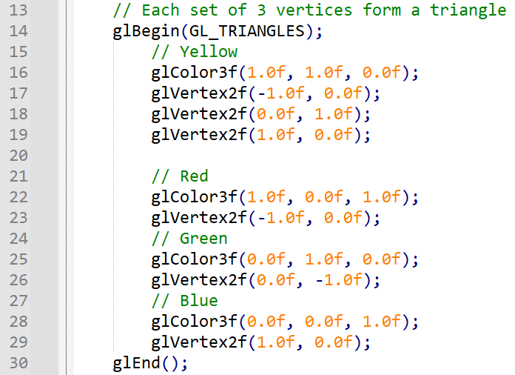
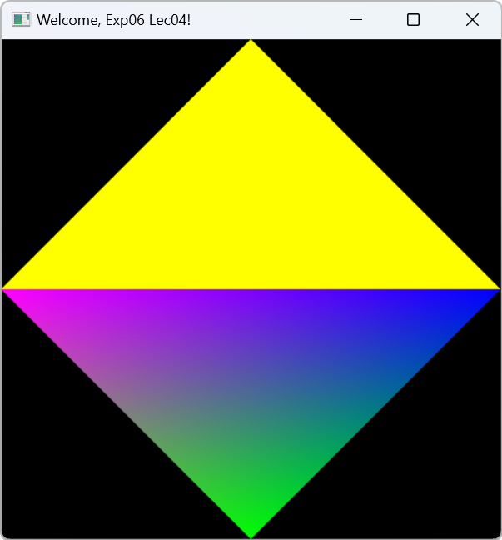
Code Example: exp06_lec04.cpp

Slide 23
Texture Coordinate
y
Mapping
(0.0, 1.0)
(-1.0, 0.0)
(1.0, 0.0)
x
height
(0.0, -1.0)
wide
Texture space
Display buffer / frame buffer

Slide 24
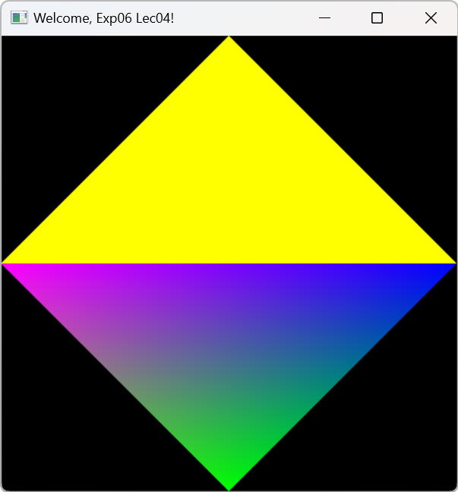
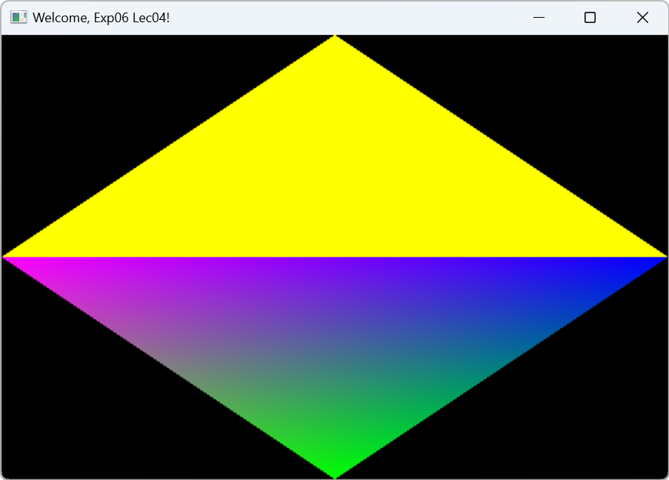
Texture Coordinate

Slide 25
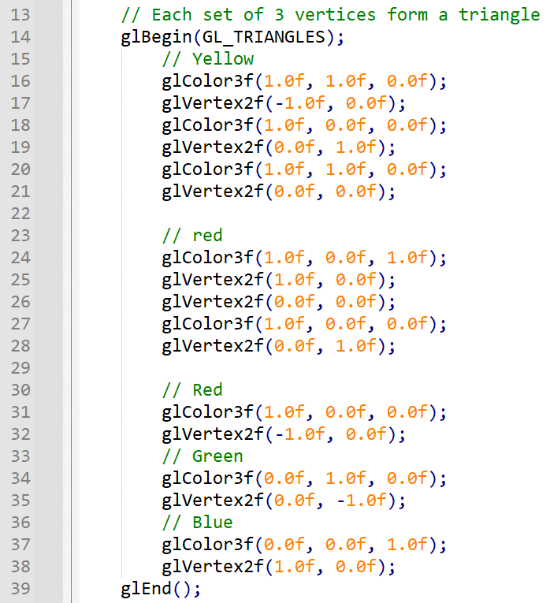
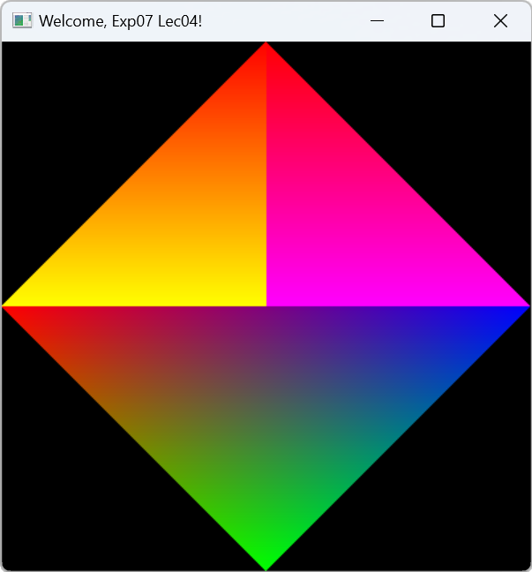
Code Example: exp07_lec04.cpp

Slide 26
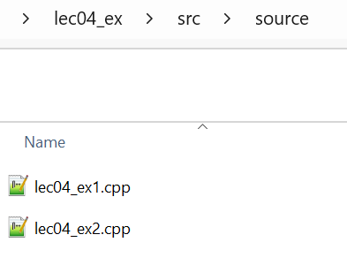
Exercise
Create a folder lec04_ex
Create CMakeLists.txt and subfolder source
In the folder source, create two C++ files lec04_ex1.cpp and lec04_ex2.cpp

Slide 27
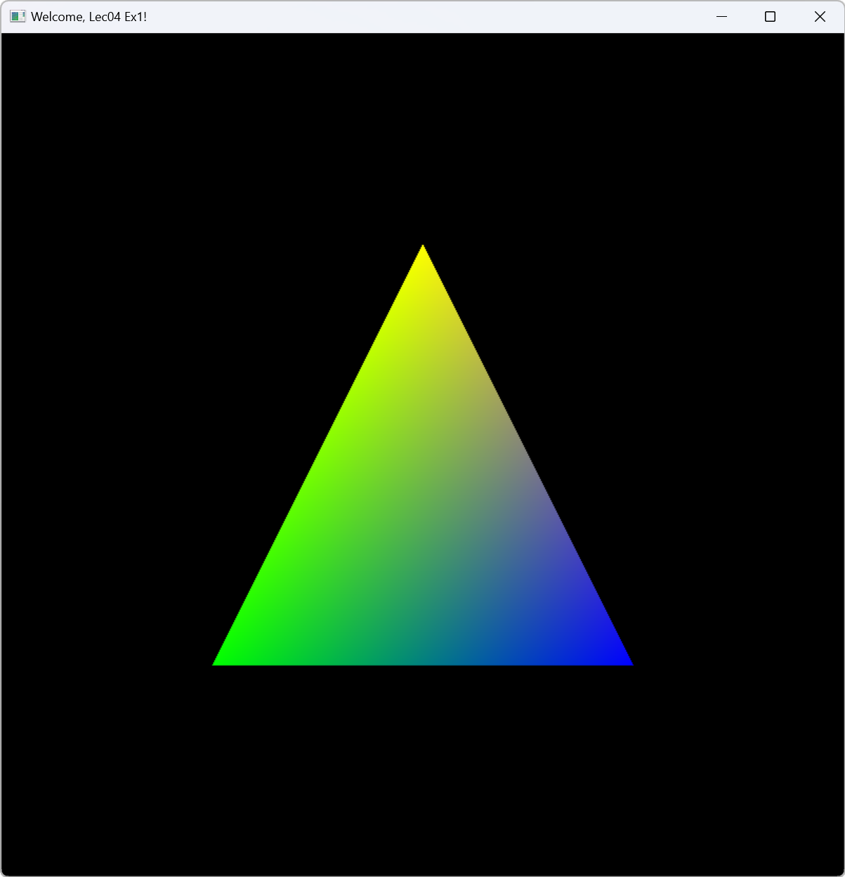
Expected Result: lec04_ex1.exe

Slide 28
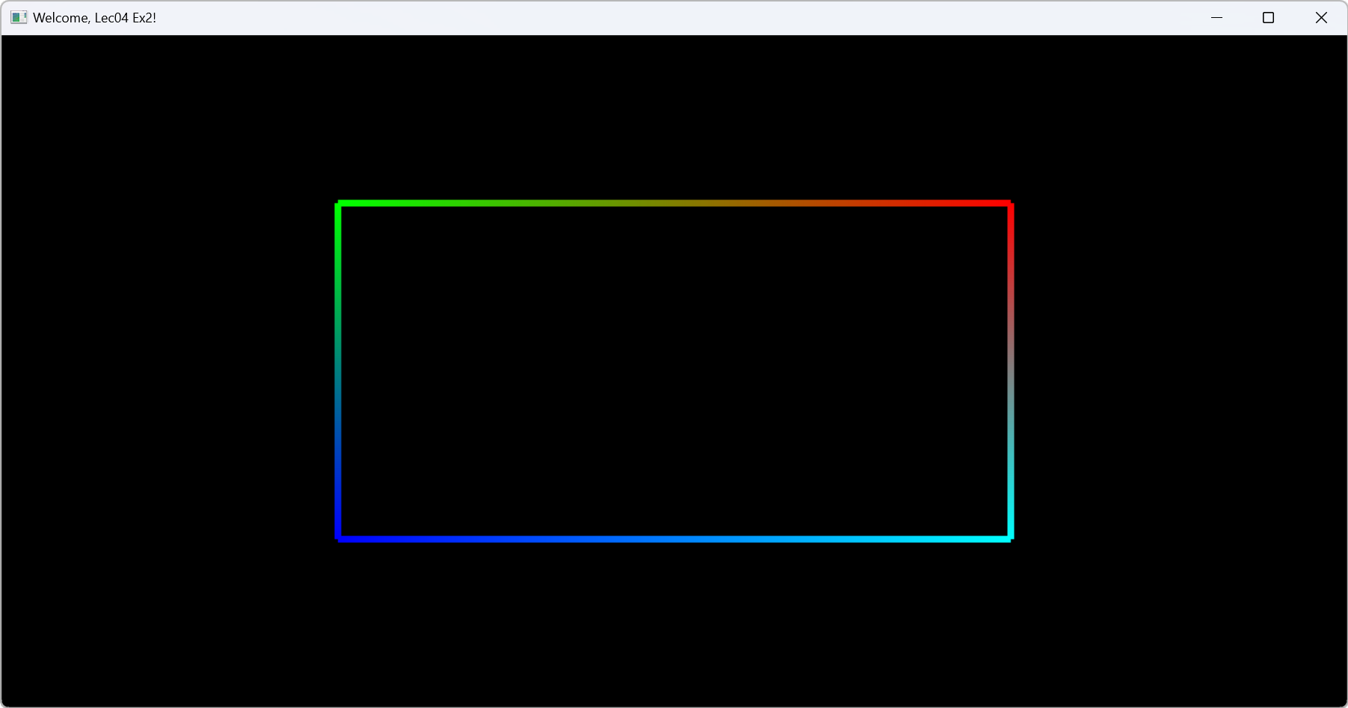
Expected Result: lec04_ex2.exe

